Slide 1

Problem Solving Session
The remainder of today’s class will comprise the problem solving session (PSS).
Your instructor will divide you into teams of 3 or 4 students.
Each team will work together to solve the following problems over the course of 20-30 minutes.
You may work on paper, a white board, or digitally as determined by your instructor.
You will submit your solution by pushing it to GitHub before the end of class.
Your instructor will go over the solution before the end of class.
If there is any time remaining, you will begin work on your homework assignment.
Class participation is a significant part of your grade (20%). This includes in class activities and the problem solving session.
Your Course Assistants will grade your participation by verifying that you pushed your solutions before the end of the class period each day.

Slide 2

Problem Solving Team Members
Michael Scalzetti
Nicholas Milonni
Vishwesh Venkatramani
Record the name of each of your problem solving team members here.
Do not forget to add every team member’s name! Your instructor (or course assistant) may or may not use this to determine whether or not you participated in the problem solving session.

Slide 3
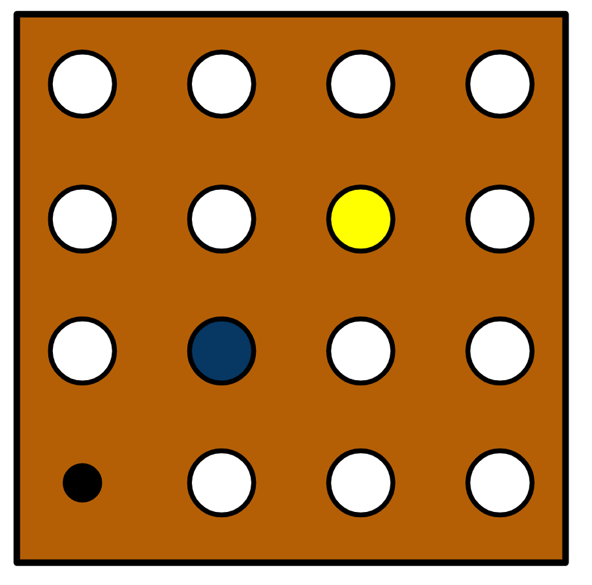
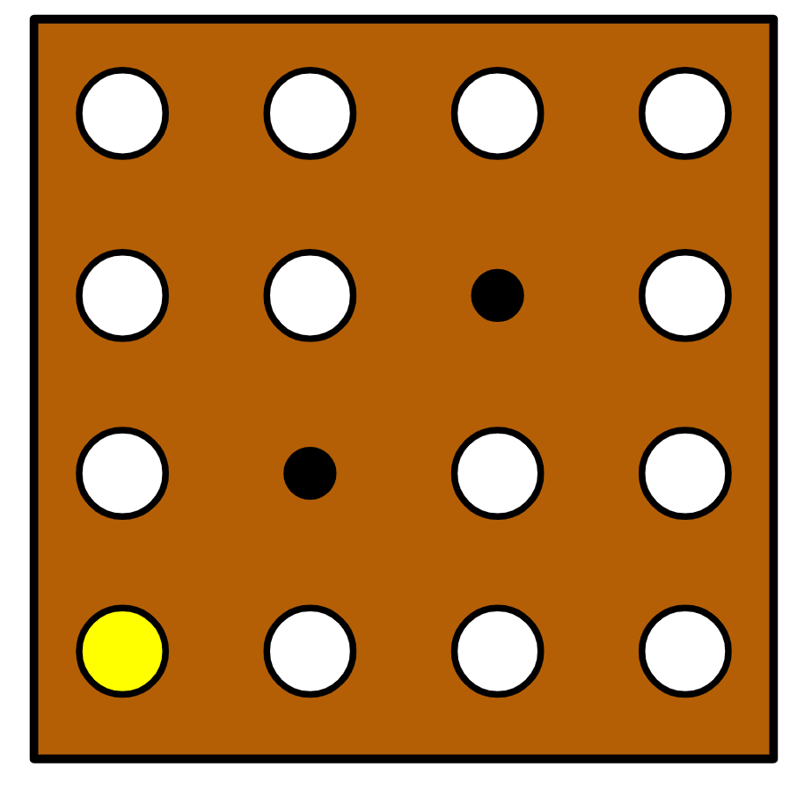
The Peg Game
The Peg Game is played on a rectangular board with holes arranged into rows and columns.
Pegs are placed into some of the holes while at least one hole is left empty.
A valid move requires that one peg "jump" another, sort of like checkers.
Jumps can be made horizontally, vertically, or diagonally.
For example, the yellow peg in the example to the right can jump the blue peg.
The yellow peg is moved diagonally to the empty hole on the far side of the green peg.
The blue peg is then removed from the board.
The game is won when there is only one peg left on the board.
A stalemate occurs when there are two or more pegs remaining but no more valid moves.
A valid move must jump a single peg. The jumped peg is removed from the board.

Slide 4
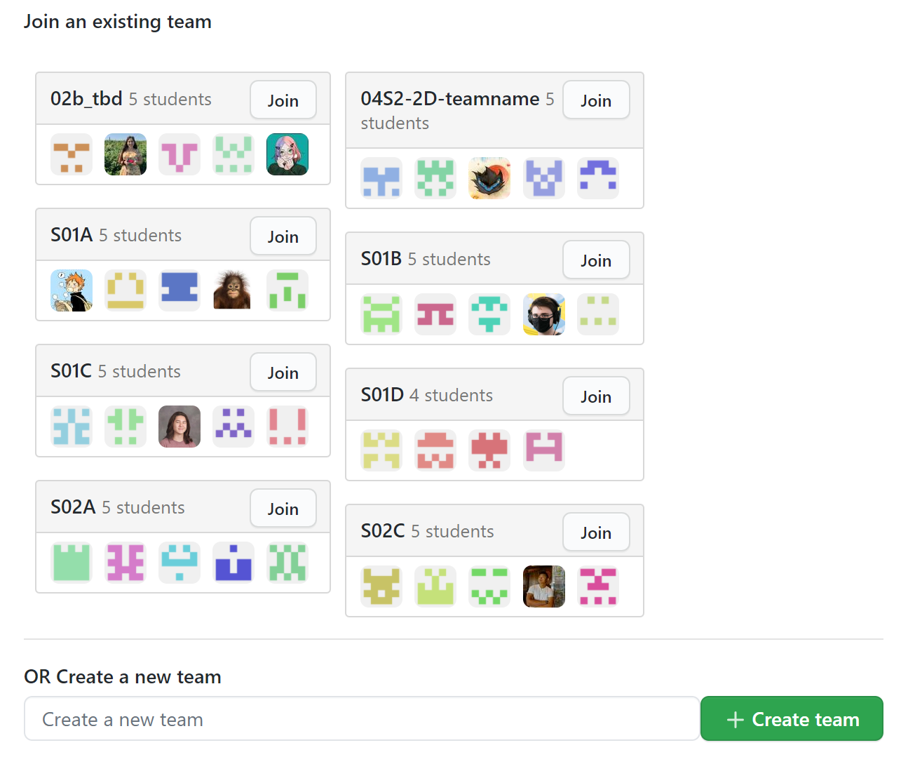
Join the Team
Your instructor will share a GitHub Classroom assignment invitation with you. Unlike the other assignments you have done for this course, the project will require you to create or join a team.
Before proceeding further ask your instructor for guidelines regarding team names.
Select one member of your team to be the first to click on the assignment invitation. GitHub will present that person with the option of creating or joining a new team. This person should create the new team. This will automatically create a new repository with any starter code for the team to use. Be sure to name the team according to your instructor's guidelines!
Only after the team has been successfully created should the remaining team members click the assignment link and join the team.
Do not race each other to click the link! Choose one team member to create the team. Be sure to follow any team naming guidelines provided by your instructor.

Slide 5
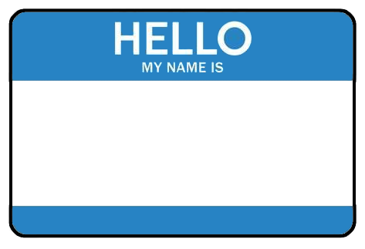
Teamwork
Once everyone on the team has accepted the assignment, you should each clone a copy of the GitHub repository to the computer that you will be using for the rest of today's exercises.
You should then take turns working through the following steps (do not try to do this all at once):
Share your screen with your team.
Pull the latest version of the repository. If you do not pull first, you may get an error.
Add your name and email to a file named "readme.txt" in the data directory of your repository.
Commit and push the file to the repository.
Repeat until every team member has added their name and email to the repository.
TEAM PLAYER
The purpose of this exercise is to make sure that everyone on the team has access to clone, pull from, and push to the repository.
Please take turns and share your screen with your team.

Slide 6
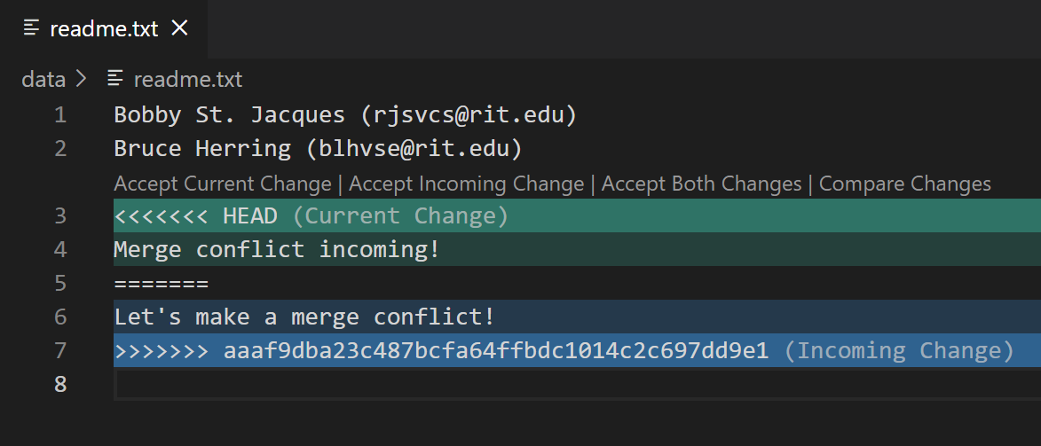
Merge Conflicts
Practice resolving merge conflicts by following these steps:
Make sure that everyone on the team has pulled the latest version of the repository.
Two team members should simultaneously edit the readme.txt file and add a new line to the bottom of the file. It does not matter what the text says as long as each person types something different.
One team member should push their code first. Wait until the push completes.
The second team member should then try to push their changes. The push should be rejected forcing them to pull first.
The pull will cause a merge conflict.
Resolve the conflict by opening the file, scrolling to the conflict (if necessary), and accepting both changes (see left).
Follow the Git workflow to push the merged file to GitHub.
Repeat the above until every member of the team has had a chance to resolve at least one merge conflict.
If a file with a merge conflict is opened in VS Code, it will helpfully highlight the conflict and provide links to fix the problem quickly.
For today, choose the Accept Both Changes option.
In the event that multiple merge conflicts occur (in the same or different files), you will need to resolve them all before you can push your code.

Slide 7
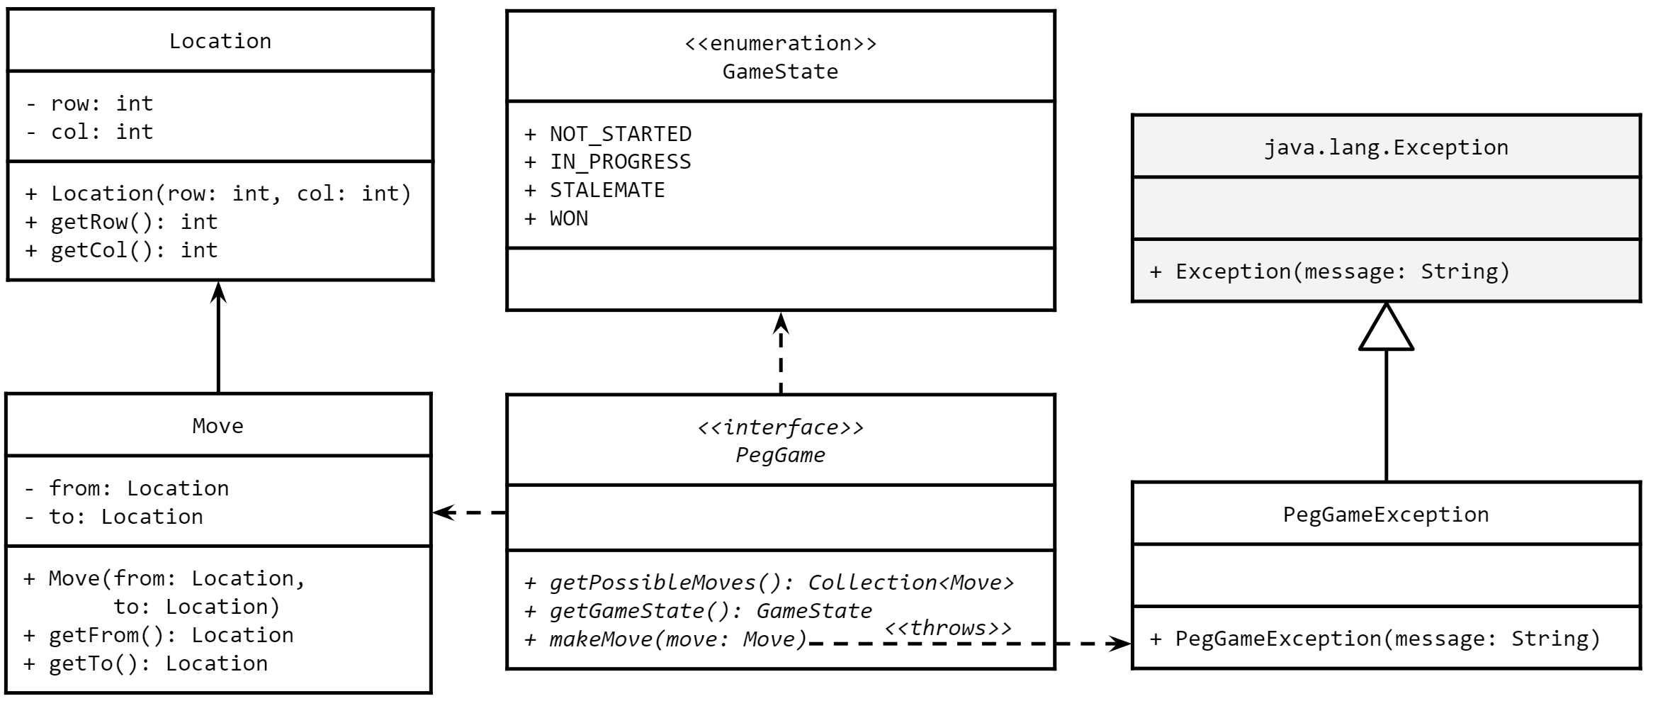
A Partial Design
Refer to this full UML class diagram as needed while you and your team work through the rest of this assignment.

Slide 8


Pair Programming
Pair programming is a technique during which two developers collaborate to solve a software problem by writing code together.
One developer takes on the role of the driver.
Shares their screen.
Is actively writing code.
The other developer(s) takes on the role of the navigator.
Watches while the driver codes.
Takes notes.
Asks questions.
Points out potential errors.
Makes suggestions for improvements.
The driver and navigator regularly switch roles, e.g. every 10-20 minutes.
Set a timer!
Push your code!
For the rest of today's problem solving session, you and your team will practice pair programming with one team member acting as the driver and the remaining team members acting as the navigators.
Everyone on the team should take a moment to watch this short video on pair programming.
When you are the driver, you should be using Zoom or Discord to share your screen. Be sure to push your code and switch roles every 10-20 minutes!

Slide 9
Location
Every position on the Peg Game board can be addressed using its row and column location.
Both rows and columns are numbered from 0 to length-1.
For example, on a 4x5 board the rows would be numbered 0 to 3 and the columns would be numbered 0 to 4.
Using the UML to the left, implement a Location class in the peggame package.
You must include the methods and fields in the UML, but you may add additional behavior as you see fit. Consider:
Will you need to determine if two different Location objects represent the same position on the board?
Will your Location class need to work with hashing data structures like HashSet or HashMap?
Will you want to print a nicely formatted version of the class?
Location
- row: int - col: int
+ Location(row: int, col: int) + getRow(): int + getCol(): int
While you are required to include the state and behavior in the diagram above, you may add additional state and behavior if you find it necessary to do so.

Slide 10
Move
A move comprises two locations.
The location from which a peg is being moved.
The location to which a peg is being moved.
For example the move (0,0) to (2,0) would indicate moving a peg from the top left corner of the board vertically down two rows.
Using the UML to the right, implement a Move class in the peggame package.
You must include the methods and fields in the UML, but you may add additional behavior as you see fit. Consider:
Will you need to determine if two different Move objects represent the same move, i.e. they have the same from and to locations?
Will your Move class need to work with hashing data structures like HashSet or HashMap?
Will you want to print a nicely formatted version of the class?
Move
- from: Location - to: Location
+ Move(from: Location, to: Location) + getFrom(): Location + getTo(): Location
While you are required to include the state and behavior in the diagram above, you may add additional state and behavior if you find it necessary to do so.

Slide 11
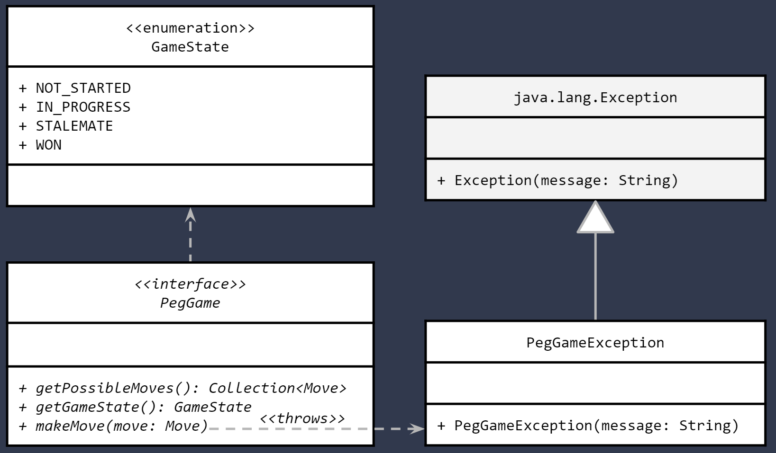
The Peg Game
Using the UML to the left as a guide, implement the remaining required classes and interfaces with your team.
The GameState enumeration, which defines the possible states that a game may be in.
The PegGameException class, which is a custom exception that may be thrown by a PegGame if an invalid move is attempted.
This class will be a checked exception and so should extend the java.lang.Exception class.
The PegGame interface, which must be implemented by a class that can be used to play a Peg Game.
The makeMove(Move) method throws a PegGameException if the attempted move is invalid.
All new types should be in the peggame package.
Refer to the full UML diagram if needed.
The classes that you've implemented today are only part of what will be the full solution to this part of the project.

Slide 12
Man in the Middle
The Move class comprises two locations: the location from which a peg is being moved, and the location to which it is moving.
When a valid move is executed, the peg in between those two locations is removed from the board.
However this third location is not part of the move class (nor should it be).
Not all Peg Games are played on rectangular boards, so "in between" means different things for different shapes.
Assuming that a move is being made on a rectangular board, how will you determine the location that is between the two end points of the move?
Work with your team to try and come up with a strategy for determining the location of the "in between" peg given only the to/from locations.
A move may be horizontal, vertical, or diagonal.
Try experimenting with jumps to and from different locations on a board. Can you find a pattern for the "in between" location relative to the to/from locations?
FROM:
(0, 2)
BETWEEN:
(1, 1)
TO:
(2, 0)
A move in the Peg Game requires that one peg "jump" over another to remove it from the board.

Slide 13
Meeting Times
Date/Time | Location | Area of Focus
3/20@1:00PM | Discord | makeMove
3/24@8pm est | Discord
3/25@8pm est | Discord
3/31@8pm est | Discord
This project counts for significantly more than a normal homework assignment. You and your team should plan on spending more time than usual working on it.
You should also plan to work together as much as you can, even if that meets setting up a remote meeting using Zoom or Discord.
Use the table to the right to plan at least 3 meetings over the course of this part of the project. Each meeting should be at least 1 hour.
An example has been provided. You should delete it.

Slide 14

If You Made it This Far...
Your team is off to a good start, but you are not quite finished with Part 1 of the Project yet.
Not quite...
You still need to create a working implementation of the Peg Game that can be played on a rectangular board with any number of rows and columns.
You will also need to write code to read files containing different board configurations and a command-line interface that a human user can use to play the game.
If you have time remaining in class, you should begin reading the full project description, which you will find on MyCourses.

